Slide 1


Credit Card Fraud Detection on Synthetic Datasets
Lincoln Brown DSC680-T301 Professor Iranitalab
Notes:
Hello everyone, my name is Lincoln Brown, and I would like to welcome you to this presentation on credit card fraud detection using synthetic datasets.

Slide 2
Background
The Problem:
Credit card fraud resulted in $34.6 billion losses in 2022.
Traditional rule-based methods for fraud detection can’t keep up.
The Opportunity
Machine learning fraud detection models provide potential for improved performance.
Synthetic datasets simulate real-world purchases without privacy concerns.
Notes:
Credit card fraud is a significant and growing problem for financial institutions and businesses with global annual losses reaching $34.6 billion in 2022.
Not only does credit card fraud affect the bottom-line of companies, it also erodes customer trust, brand reputation, and operational efficiency.
Businesses and financial institutions are often required to reimburse customers for fraudulent transactions and have little control over preventing credit card fraud. This puts them into a reactive position, highlighting the importance of being able to reliably detect fraud in real time.
Traditionally, credit card fraud was detected using rule based systems such as flagging any transaction over a specific dollar amount or made from an unusual location outside of the customer’s normal geographic area.
These traditional systems struggle to keep up with large volumes of transactions and illustrate why more advanced detection systems are necessary. The development of machine learning has enabled fraud detection systems to process a higher number of transactions and has improved the fraud detection capabilities. In this presentation we will look at two such machine learning models, a Random Forest model and a Long Short-Term Memory Model (also known as LSTM).

Slide 3

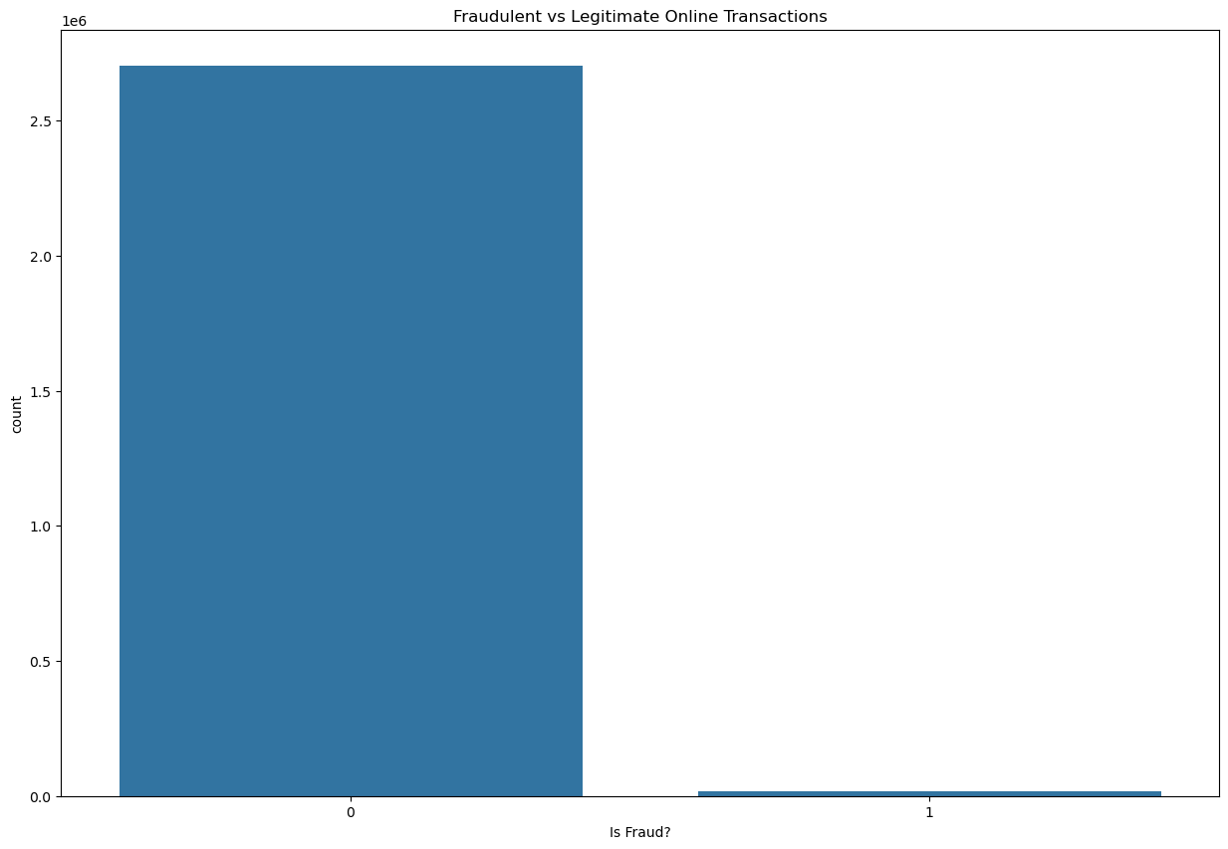
Synthetic DATASET
The dataset was uploaded to Kaggle by Erik Altman.
The data was generated by IBM to simulate credit card transactions for 2000 synthetic users with over 20 million transactions.
Due to limited computation resources, the dataset was limited to transactions that were placed online. This limited the transactions to 2 million transactions.
Notes:
The dataset used in this project was obtained from Kaggle. It is s a synthetic dataset, whose author is Erik Altman. The data was generated by IBM to simulate credit card purchases for over 2000 synthetic users with over 20 million total transactions. The dataset contains a transactions dataset and a user dataset. The transactions dataset contains fifteen features of which, 8 were selected for use in training the models. The user dataset, which contains additional demographic and user-specific information, will not be used in this project. This dataset was excluded in order to prevent adding unnecessary complexity and to allow for future model adaptation without including sensitive user data. Initially, both a Random Forest model and a LSTM model were created on all the records in the dataset. With limited computational resources, training the models took a long time and the results were less than desirable. To reduce the dataset size, the focus was shifted to transactions that were made online.
Although the majority of the fraudulent transactions were made online, the overall online dataset was still highly imbalanced, as we can see in this graph.

Slide 4
Methods
Random Forest Model – Ensemble Learning algorithm using a tree ML algorithm.
Long Short-Term Memory (LSTM) Model – Improved version of a Recurrent Neural Network (RNN).
Notes:
Two different types of models were used, a Random Forest Model and a Long Short-Term memory model.
Random Forests are an ensemble learning algorithm that use a tree machine learning algorithm that builds multiple decision trees during the training phase. Each decision tree is composed of a random subset of the data set to measure a random subset of features in each partition. Utilizing random subsets of features introduces variability among individual trees, which can help reduce the chances of overfitting and improve overall prediction performance. The RF model aggregates the predictions of many decision trees, which provides more reliable and accurate results compared to a single decision tree.
LSTM (Long Short-Term Memory) Models
LSTM models are an improved version of a recurrent neural network (RNN) designed by Hochreiter and Schmidhuber. Traditional RNNs have a single hidden state that is passed through time, which makes it difficult for the model to learn long-term relationships. LSTMs improve on this model using a memory cell that allows the model to hold information for an extended period of time. This capability to retain information makes LSTM models effective for sequential data such as time-series or transactional data in credit card fraud detection.

Slide 5
Performance Metrics
The models' performance on fraudulent transactions were evaluated using five key metrics:
Accuracy: The proportion of all classifications, both fraudulent and legitimate, that were correct.
Precision: The proportion of transactions classified as fraudulent by the model that were actually fraudulent.
Recall: The proportion of all actual fraudulent transactions that the model correctly identified as fraudulent.
F1 Score: The harmonic mean of precision and recall, balancing the trade-off between false positives and false negatives.
Area Under the Receiver Operating Characteristic (ROC-AUC): A measure of the model's ability to differentiate between fraudulent and legitimate transactions.
Notes:
The models' performance on fraudulent transactions were evaluated using five key metrics:
Accuracy: The proportion of all classifications, both fraudulent and legitimate, that were correct.
Precision: The proportion of transactions classified as fraudulent by the model that were actually fraudulent.
Recall: The proportion of all actual fraudulent transactions that the model correctly identified as fraudulent.
F1 Score: The harmonic mean of precision and recall, balancing the trade-off between false positives and false negatives.
Area Under the Receiver Operating Characteristic (ROC-AUC): A measure of the model's ability to differentiate between fraudulent and legitimate transactions.

Slide 6
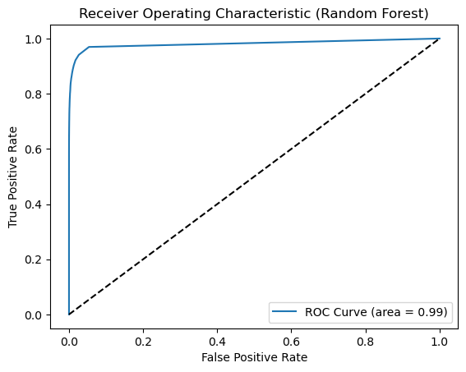
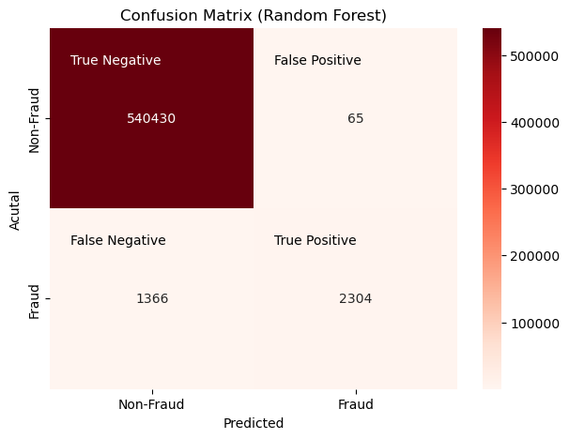
Random Forest Model Results
Notes:
From these results, we can see that the Random Forest model performed reasonably well at identifying fraud, with an F1 score of 0.76 for fraudulent transactions. The model maintains a recall of 0.63 for fraudulent transactions, but this metric could be improved to correctly identify more false negatives (fraudulent transactions marked as non-fraud). The ROC-AUC of 0.99 indicates that it is capable of distinguishing between the classes well.

Slide 7
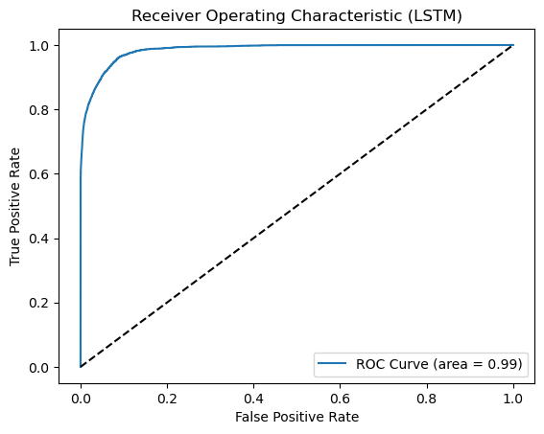
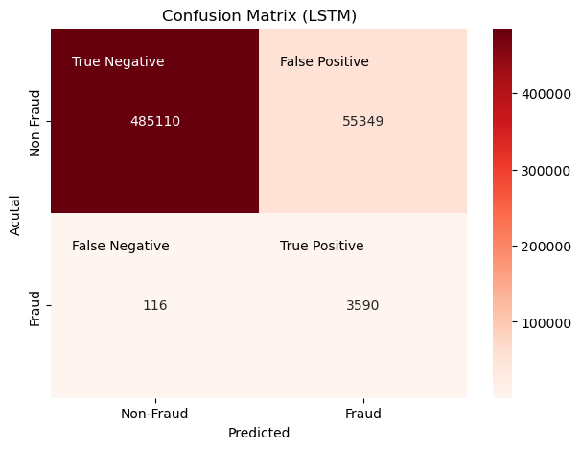
LSTM Model Results
Notes:
The LSTM model shows a significantly higher recall of 097 for detecting fraudulent transactions compared to the RF’s 0.68, indicating that it is better at minimizing false negatives (missed fraudulent transactions). However, it achieves this at the cost of a much lower precision score, which results in a significantly lower F1 score of 0.11 for fraudulent transactions. Therefore, this model is better suited for instances where identifying fraud outweighs the potential for many legitimate transactions being flagged as fraudulent.

Slide 8
Challenges
Imbalanced Dataset
Dataset size
Notes:
There were two significant challenges in this project: addressing the imbalanced dataset, since most of the fraudulent transactions only made up a small percentage of the total. This made it difficult for the models to identify fraud. To mitigate this, class weight balancing was applied, which increased the penalties for misclassifying fraudulent transactions.
Another significant challenge was the sheer size of the dataset, which contained over twenty million records. Initial model training sessions took over five hours to complete, which made it difficult to adjust the models under the time constraints. To improve model training time, the models were only trained on online transactions, resulting in a dataset that contained about two million records, but was still sufficient to identify fraud.

Slide 9

Implementation PLAN
Which model to use?
When to use Random Forest
This model is preferable when it is more important to prioritize lowering false positives at the cost of some fraudulent transactions not being flagged.
When to use LSTM
This model is preferable when it is more important to capture a higher number of fraudulent transactions at the cost of a higher number of false positives.
Notes:
Implementing the models in this project would require defining the type of environment they are going to be deployed in. In environments where a balanced approach that aims to minimize the number of legitimate transactions being flagged as fraudulent is desired, the Random Forest model is the better model.
In high-risk areas where fraudulent transactions need to be identified even at the cost of a high number of legitimate transactions being flagged as fraud, the LSTM model will perform better.
Both models will need to be retrained before implementing them on real-world data.
Further steps would be to incorporate either model into the data pipeline, with real-time data being ingested and sent through preprocessing before being sent to the model. The model could then also be set up to continuously learn and improve using incremental training.

Slide 10
Ethical Considerations
This project prioritized the ethical use of the data and strove to protect any possible sensitive information. The dataset used for this project was a synthetic dataset, which greatly helps because no actual customer information was used in the project.
The user dataset was not included in the models used in this project to prevent the necessity for including any potentially sensitive data in real-world deployments.
Notes:
This project prioritized the ethical use of the data and strove to protect any possible sensitive information. The dataset used for this project was a synthetic dataset, which greatly helps because no actual customer information was used. Additionally, the user dataset was not included in the models used in this project to prevent the necessity for including any potentially sensitive data in real-world deployments.

Slide 11
Conclusion
Both models successfully identified fraudulent transactions with class balancing being critical for addressing data imbalance.
Random Forest: Balanced precision and recall, suitable for environments prioritizing low false positives.
LSTM: High recall but low precision, ideal where detecting fraud outweighs the cost of false positives.
Further improvements:
Utilize the full dataset for better generalization.
Refine models with additional computational resources.
Notes:
In conclusion, the two models that were trained and evaluated as part of this project successfully identified fraudulent credit card transactions. Using class balancing to address the imbalance between legitimate and fraudulent transactions proved to be critical to producing models that were capable of detecting fraud.
The Random Forest model was better at producing a balanced approach to identifying fraud, maintaining a high precision, but also demonstrating effective recall. This model will perform better in environments where minimizing false positives is necessary. Alternatively, the LSTM model had a significantly higher recall but suffered a low precision as a result. This model will perform better in environments where detecting fraudulent transactions are worth the cost of a high false positive rate.
Further refinement of the models could be achieved with more time and computational resources. Using the full dataset would help this model perform better for all transaction types instead of those only found in online transactions.
Ultimately, this project provided insights into the methodology behind developing robust fraud detection systems and illustrated how machine learning has made it possible for financial institutions and businesses to detect fraud using more than traditional rule-based systems. These models can be further refined for use with real-world datasets and with some enhancements, may find applicability outside of the target domain of detecting credit card fraud.

Slide 12
Questions
Why did you choose random forest and LSTM models?
How did you handle the imbalance in the dataset?
What were the trade-offs in your models? How do they impact real-world detection?
What are the impacts of false positives on customers?
Can your models scale to larger datasets?
What were some challenges that you faced?
What are the practical implementations of these models?
Did you have any ethical concerns when working on these models?
What could be done to improve the models in the future?
Which model do you recommend deploying and why?
Notes:
I chose Random Forest as a baseline because it has strong performance and interpretability. I chose LSTM to investigate Deep Learning’s ability to capture temporal patterns in the data.
I used class weight balancing to penalize misclassification of the minority class, which was fraudulent transactions, so that the models would focus on identifying fraud correctly.
The Random Forest model achieved a more balanced precision and recall, which minimized false positives. LSTM prioritized recall, which led to more false positives, but also better detection of fraud. The trade off is that false positives can become frustrating for customer experience. I would recommend deploying the RF model in most scenarios, but in highly critical environments where the cost of fraud is high, the LSTM is an appropriate choice.
False positives can lead to legitimate transactions being identified as fraud, which can be frustrating for customers and potentially hurting the business’ reputation.
Random Forest models are not as adaptable to larger scales as LSTM models are when paired with the appropriate computational resources.
The original dataset with over 20 million records produced really long training times. I also faced some difficulty with the highly imbalanced dataset which led to misclassification bias until the class weight balancing was implemented.
These models have applicability in real-time fraudulent transaction detection systems used to generate alerts or flag potentially fraudulent transactions.
I focused only on transactional data, leaving user data out of it, so that these models may be employed without requiring exposure to sensitive user data.
Further improvements would include using the full dataset for model training, hyperparameter tuning, and testing additional datasets.
I would recommend the Random Forest model for environments where minimizing false positives is important (such as customer facing applications). The LSTM model is better suited for high-risk environments where identifying fraud is crucial and dealing with the false positives isn’t a strong deterrent.

